Slide 1
Lab 1: Resistor Values
In this lab, we took different resistors and measured them and then compared the results against the expected value based on color-coding.

Slide 2
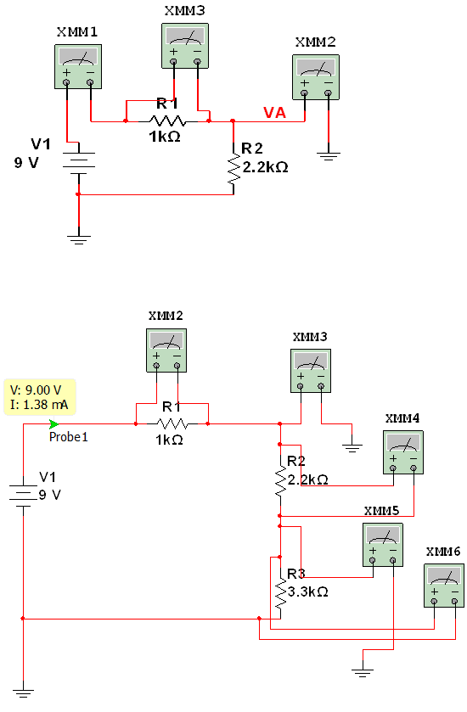
Lab 2: Resistors in Series Circuits
In this lab, we compared measured values of RT, IT, VT, ER’s, VA, and/or VB to expected values.

Slide 3
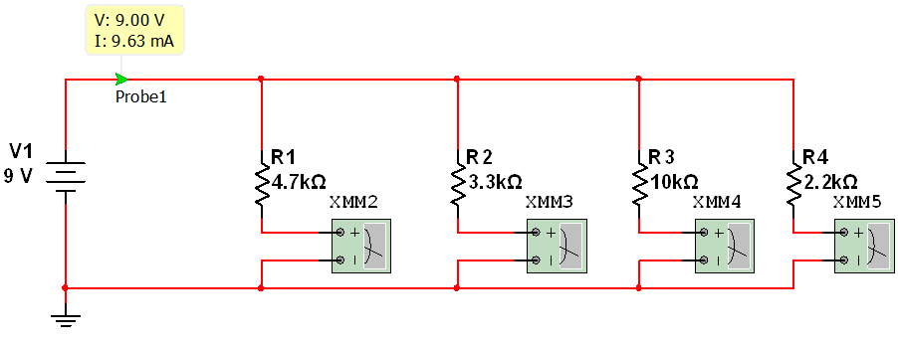
Lab 3: Resistors in Parallel Circuits
In this lab, we compared Resistance and Current values to expected results.

Slide 4
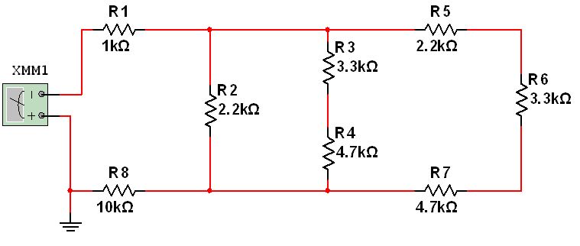
Lab 4: Series/Parallel Resistor Circuits
In this lab, we compared measured values of R’s, V’s, and I’s to expected results.

Slide 5
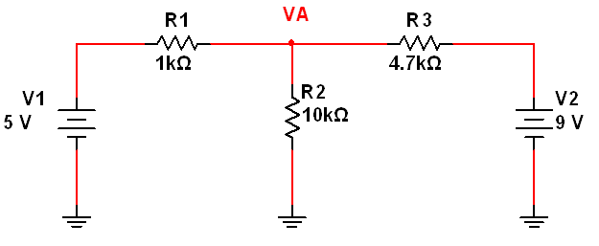
Lab 5: Resistance, Voltage, Currents: 2 Power Sources
In this lab, we compared the measured values of resistance, voltage, and current to expected results.

Slide 6
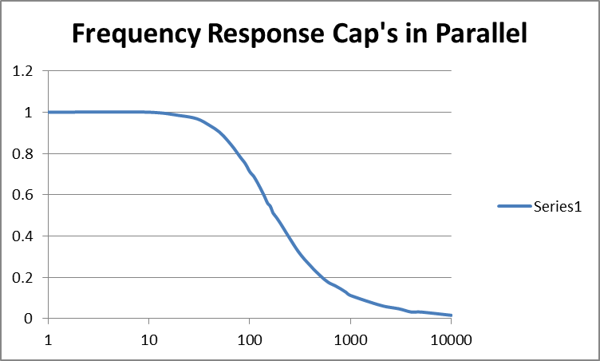
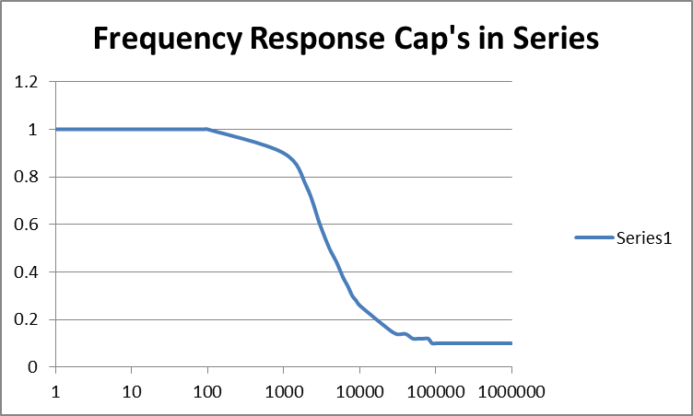
Lab 6: Parallel & Series Caps 1K Resistance
In this lab, we measured the Vin and VA based on frequency. We used capacitors with the values 1uF, .47uF, .1uF and a 1K resistor.

Slide 7
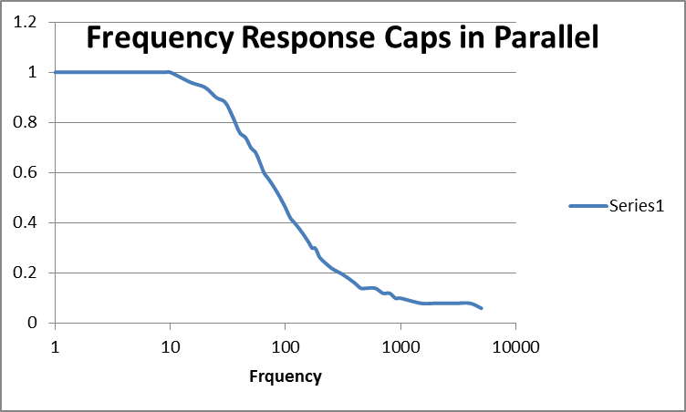
Lab 7: Parallel & Series Caps 2.2K Resistance
In this lab, we measured the Vin and VA based on frequency. We used capacitors with the values 1uF, .47uF, .1uF and a 2.2K resistor.

Slide 8
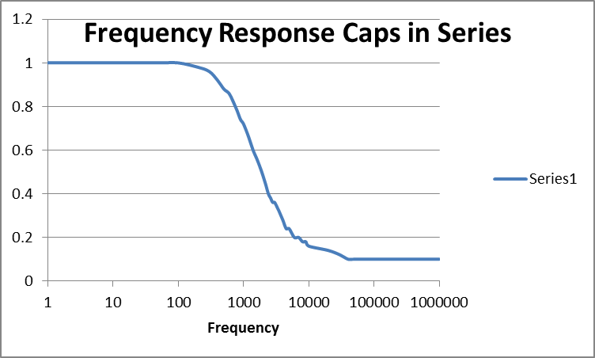

Slide 9
Lab 8: Time Constants 1K & 2.2K Resistors
In this lab, we measured the time constant and compared the differences of using 1K and 2.2K resistors and Parallel and Series circuits.
Continued next:

Slide 10
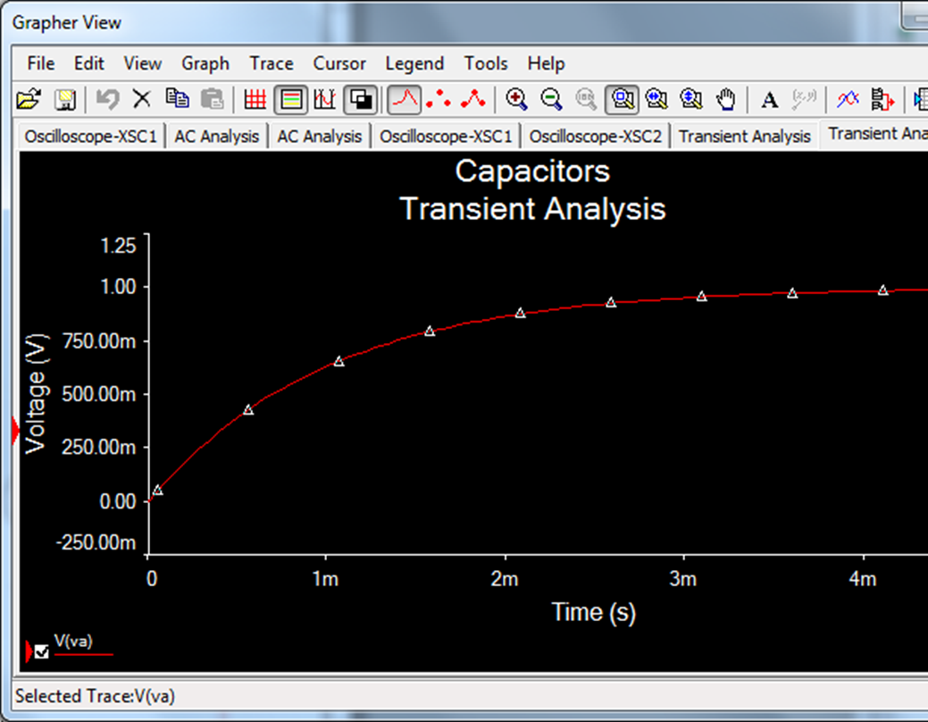
Lab 8 (cont.) Time Constants 1K Resistor

Slide 11
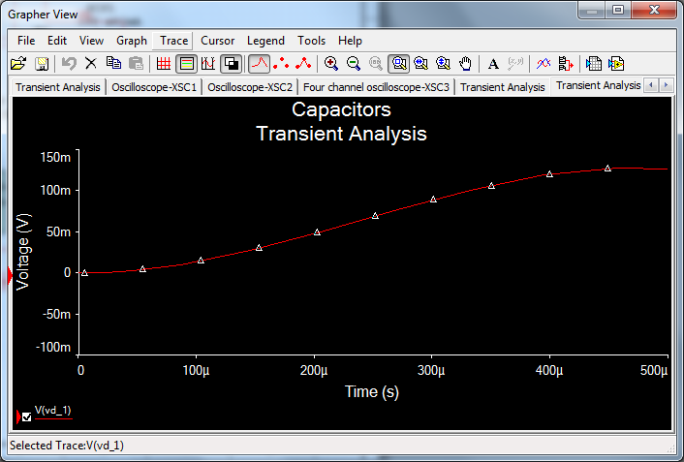
Lab 8 (cont.) Time Constants 2.2K Resistor

